Slide 1
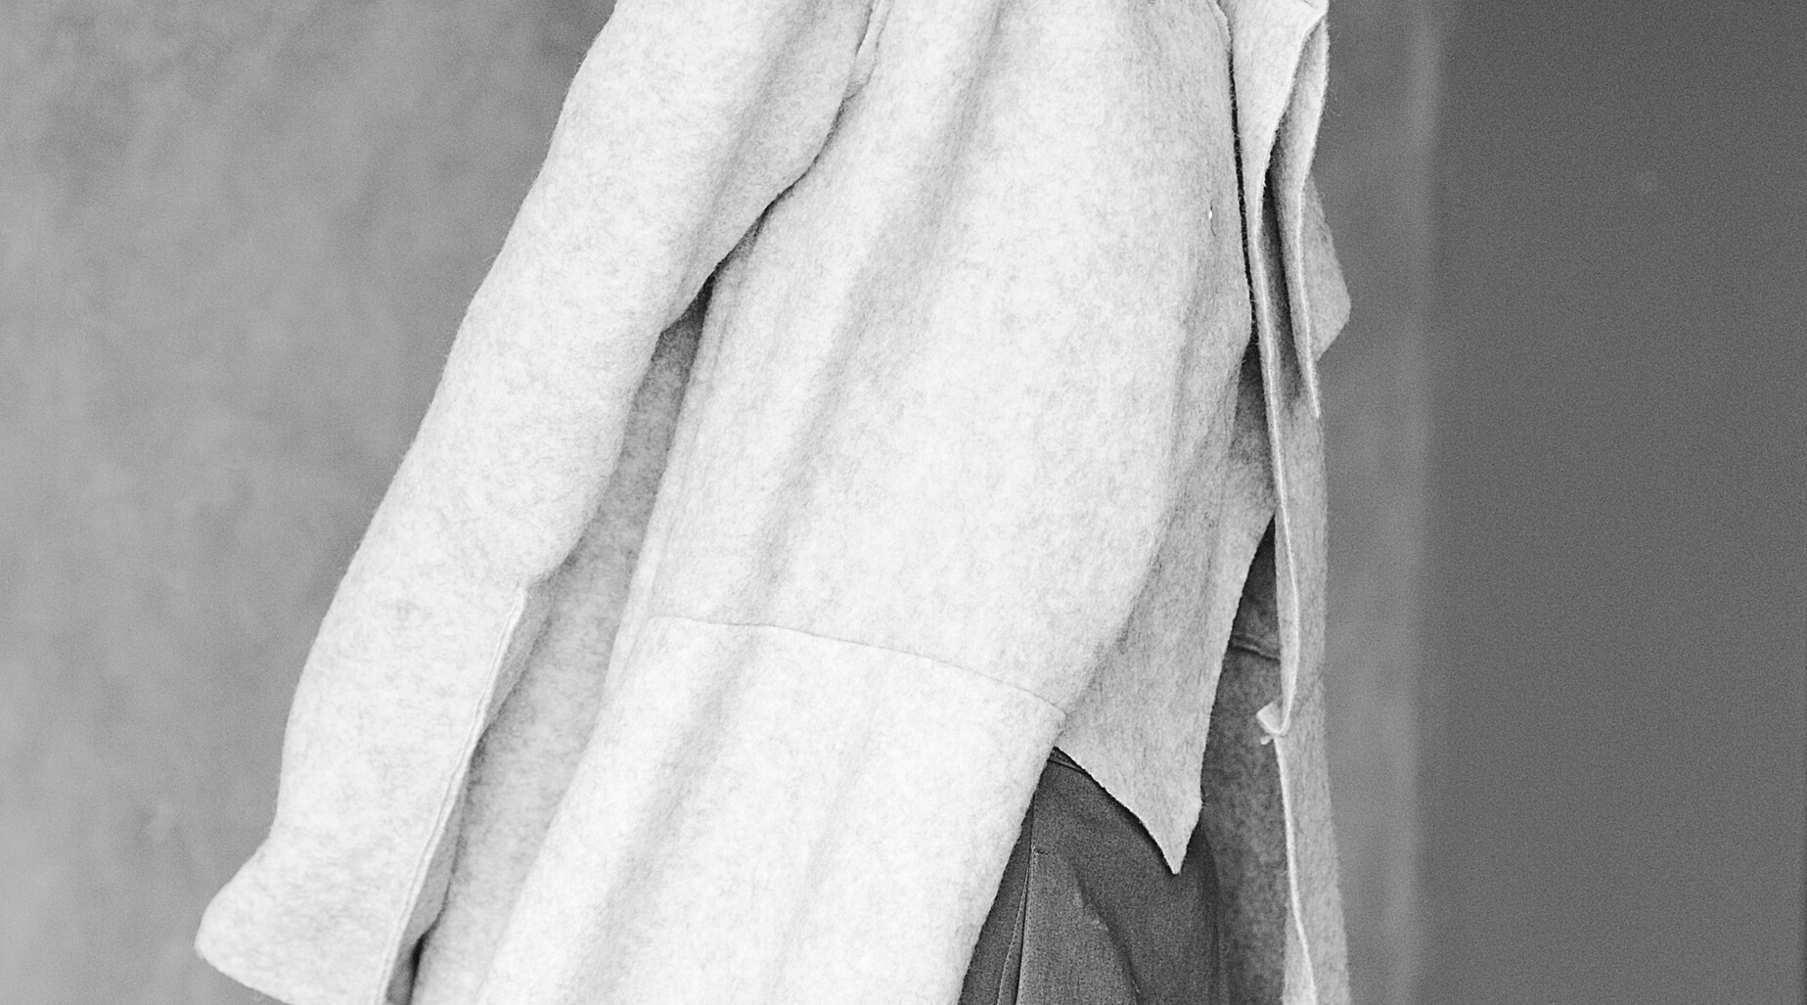
INNOVATION AND ENTREPRENEURSHIP
GROUP 1
Fast fashion

Slide 2

FAST FASHION
Inexpensive clothing produced rapidly by mass-market retailers in response to the latest trends. In previous years, fashion was divided into two seasons: spring and winter, and that was it; some magazines still do so; however, fashion has evolved, and now there is a different trend every week, so people can buy something from the store one week when it is "on trend," but not the next one, and they can easily get rid of it after only using it two or three times. Nowadays instead on having 2 seasons we have 52, each for every week.
THE PROBLEM

Slide 3
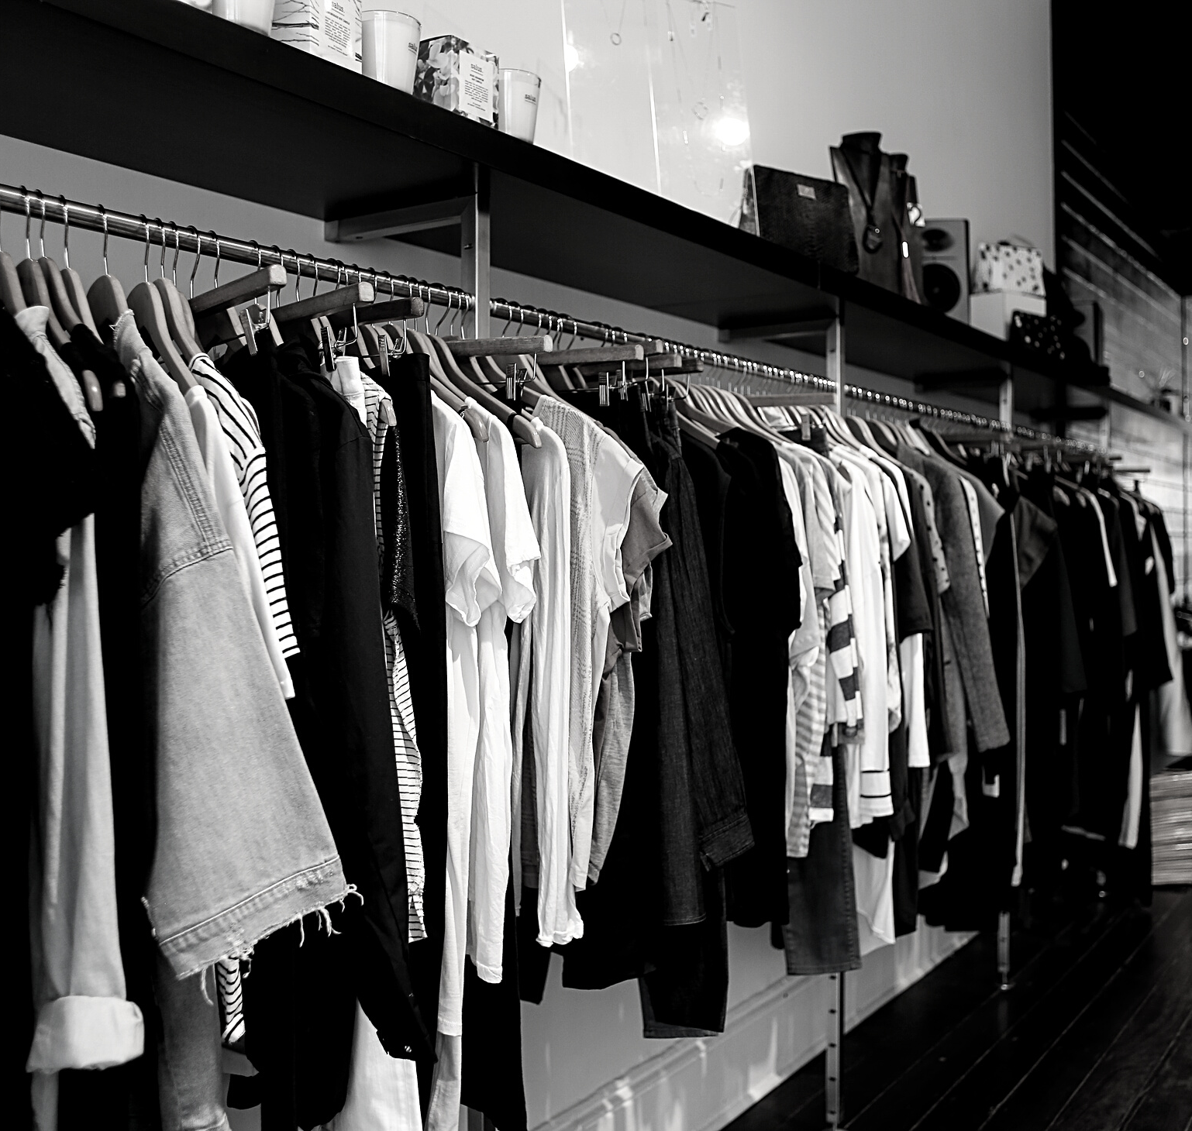
QUICK MATH
AN AVERAGE CONSUMER THROWS AWAY 70 POUNDS(31.75 KILOGRAMS) OF CLOTHING PER YEAR. GLOBALLY WE PRODUCE 13 MILLION TONS OF TEXTILE WASTE EACH YEAR 95% OF WHICH COULD BE REUSED OR RECYLCED
MF | F/W 2020

Slide 4

THE SOLUTION
Designing an app where you can buy second handed clothes, with the caveat that if the quality of the clothes are low, they won't be suitable for sale, having to pass some filters in order to be candidates for a sale. Making brand clothes accessible for everyone and reduce pollution
FLÂNER

Slide 5
MISSION
Our app tackles the negative social and environmental impacts of producing, consuming and wasting clothes by:
• Increasing our use of second-hand clothes.
• Providing people with reuse services to stop wearable clothes being thrown into the waste stream or left unused
Running education programmes and campaigns to raise awareness of the socio-
environmental impacts of clothes and to persuade and inspire people, businesses and policy makers to take action to keep clothes in use for longer.
Funding, supporting and promoting global projects to establish more sustainable
production and safer fairer conditions for people working in the supply chains making our clothes
Putting wearable clothes back into use in our charity shops
MF | F/W 2020

Slide 6
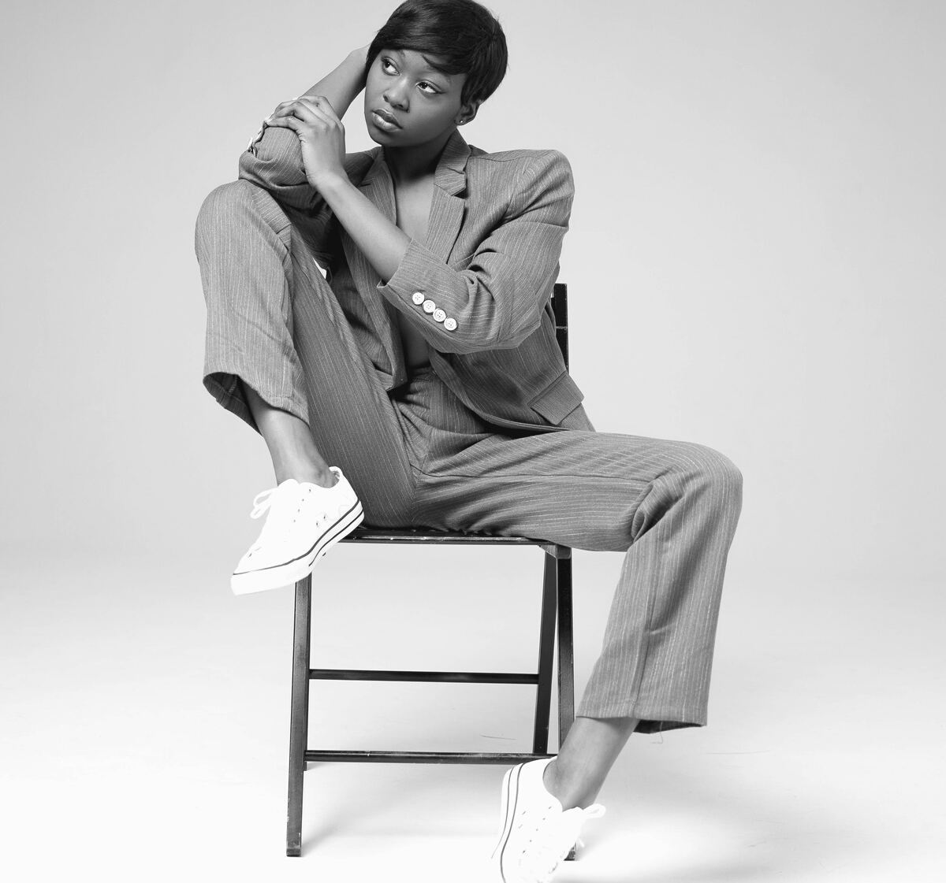
VISION
VALUES
TO CONTRIBUTE TO THE SUSTAINABLE DEVELOPMENT OF SOCIETY AND THAT OF THE ENVIRONMENT WITH WHICH WE INTERACT, GIVE CUSTOMERS WHAT THEY WANT WITH AFFORDABLE PRICE AND GOOD QUALITY
BEAUTY, QUALITY, SIMPLICITY, AND SUSTAINABILITY

Slide 7
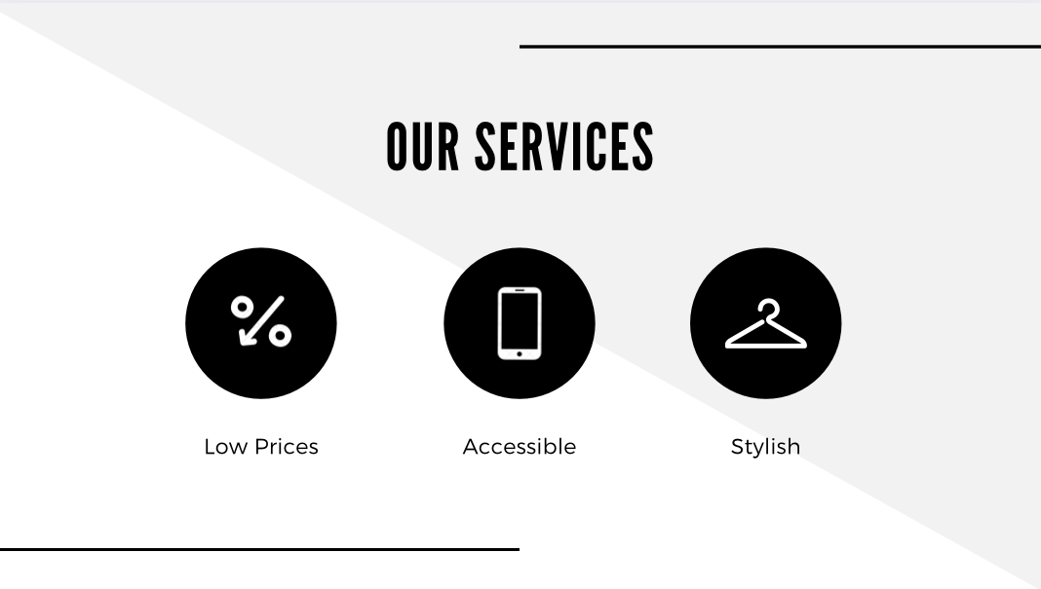

Slide 8
Our target market is young, price-conscious, and highly sensitive to the latest fashion trends. They have an advantage over traditional retailers because they do not define their target by segmenting ages and lifestyles giving them a much broader market.
Studies show that especially young people are proud to buy second-hand. This development is driven by a multitude of factors. Most of them are linked to two key drivers:
• It’s cheaper.
• It’s greener.
AUDIENCE TARGET
.As consumers become more aware of how wasteful fast fashion is, they are increasingly looking for more sustainable alternatives.

Slide 9

What is the business model of fast fashion?
The business model of fast fashion is based on consumers' desire for new clothing to wear. In order to fulfill consumer's demand, fast fashion brands provide affordable prices and a wide range of clothing that reflects the latest trends.
MF | F/W 2020

Slide 10

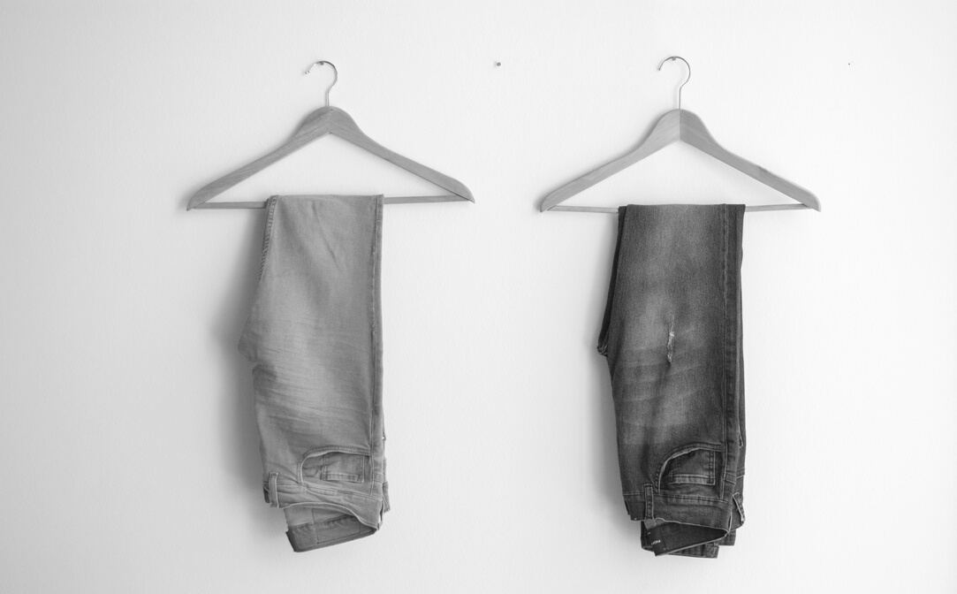
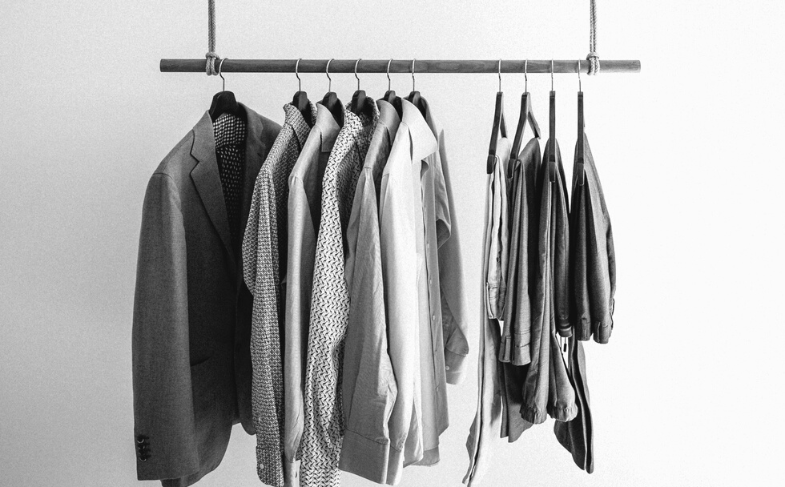
MANAGEMENT
The primary objective of fast fashion is to quickly produce a product in a
cost-efficient manner to respond to fast-changing consumer tastes in as near real time as possible.
BUSINESS STRATEGY
MARKETING
Is the key driver of fast fashion. Marketing creates the desire for consumption
of new designs as close as possible to the point of creation.
PRODUCTION
The consumer in the fast fashion market thrives on constant change and the frequent availability of new products. Fast fashion is considered to be a "supermarket" segment within the larger sense of the fashion market.

Slide 11
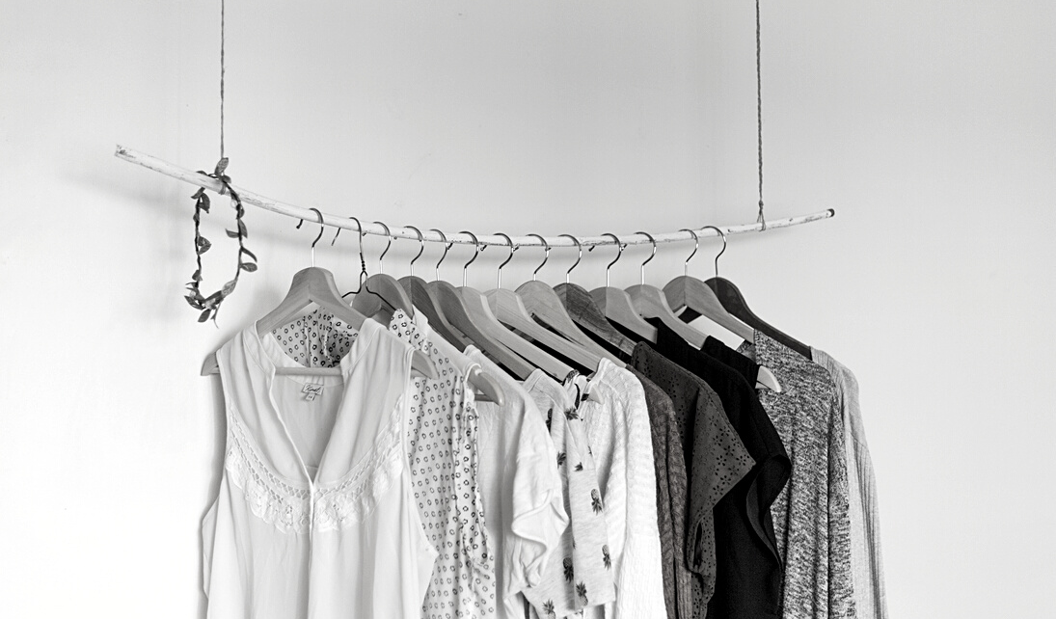
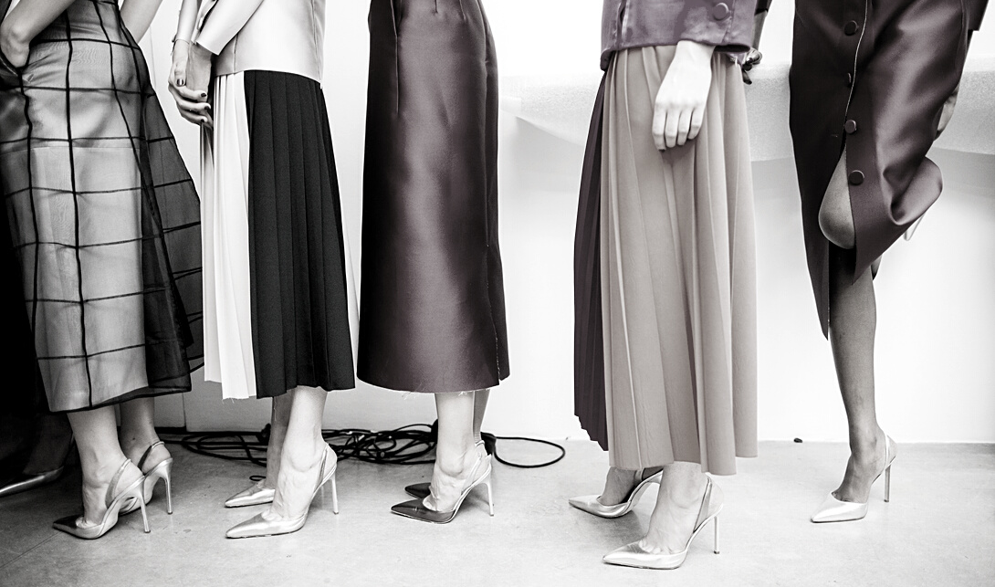
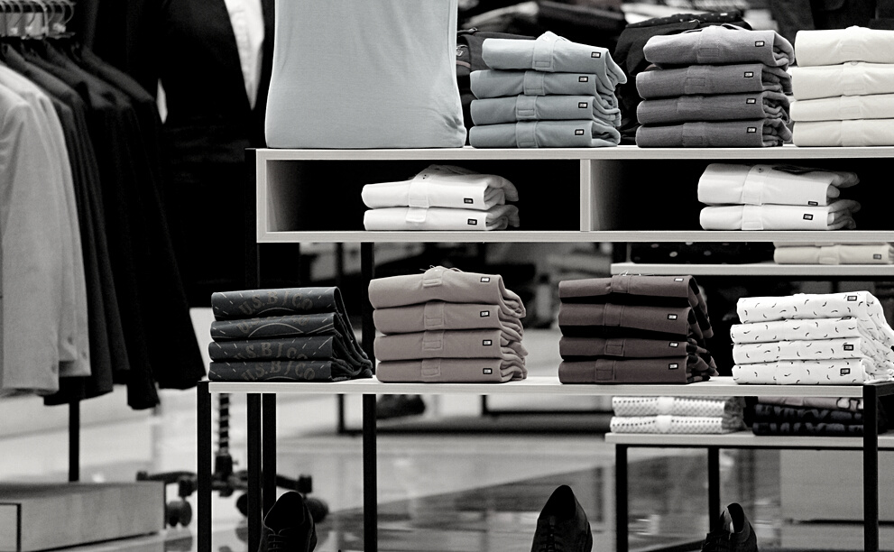
SUPPLY CHAIN
Supply chains are central to the creation of fast fashion. Supply chain
systems are designed to add value and reduce cost in the process of moving goods from design concept to retail stores and finally through to consumption. Efficient supply chains are critical to delivering the retail customer promise of fast fashion.
BUSINESS STRATEGY
VENDOR RELATIONSHIPS
The companies in the fast fashion market also utilize a range of relationships with the suppliers. The product is first classified as "core" or "fashion”.

Slide 12
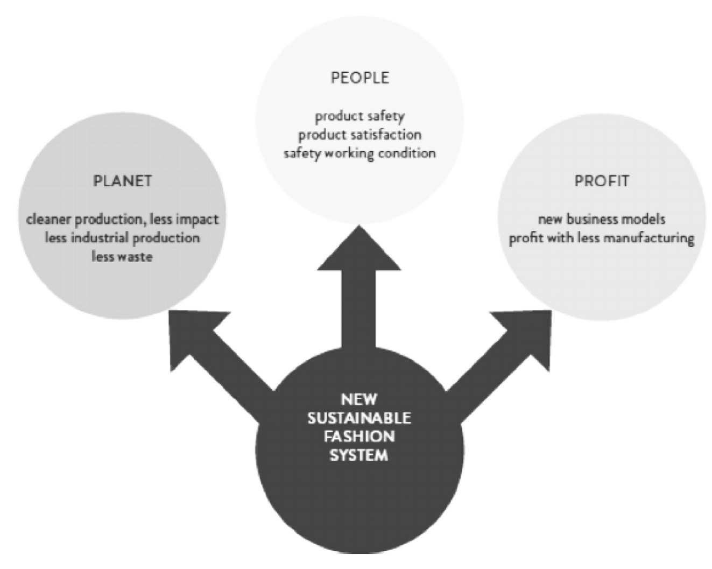
CONCEPT OF OUR PROJECT

